Slide 1
K-map
Dr. Bernard Chen Ph.D.
University of Central Arkansas
Spring 2009

Slide 2
Karnaugh Maps (K-maps)
Karnaugh maps -- A tool for representing Boolean functions of up to six variables.
K-maps are tables of rows and columns with entries represent 1`s or 0`s of SOP and POS representations.

Slide 3
Karnaugh Maps (K-maps)
An n-variable K-map has 2^{n} cells with each cell corresponding to an n-variable truth table value.
K-map cells are labeled with the corresponding truth-table row.
K-map cells are arranged such that adjacent cells correspond to truth rows that differ in only one bit position (logical adjacency).

Slide 4
Karnaugh Maps (K-maps)
If m_{i} is a minterm of f, then place a 1 in cell i of the K-map.
If M_{i} is a maxterm of f, then place a 0 in cell i.
If d_{i} is a don’t care of f, then place a d or x in cell i.

Slide 5
Examples
Two variable K-map f(A,B)=∑m(0,1,3)=A`B`+A`B+AB
A 0 1
1 | 0
1 | 1
B 0 1

Slide 6
Three variable map
f(A,B,C) = ∑m(0,3,5)= A`B`C`+A`BC+AB`C
A`B` 0 0 | A`B 0 1 | A B 1 1 | A B` 1 0
C` 0
C 1
1
 | 1 A`BC |  | 1 AB`C
A`B`C`

Slide 7
Maxterm example
(A+B) (A+B`) (A`+B`) (A`+B)
A`B` | A`B | AB | AB`
C
C`
C
 | 0 | 0 | 0
0 |  | 0
C`
f(A,B,C) = ∏M(1,2,4,6,7)
=(A+B+C`)(A+B`+C)(A`+B+C) )(A`+B`+C) (A`+B`+C`)
Note that the complements are (0,3,5) which are the minterms of the previous example

Slide 8
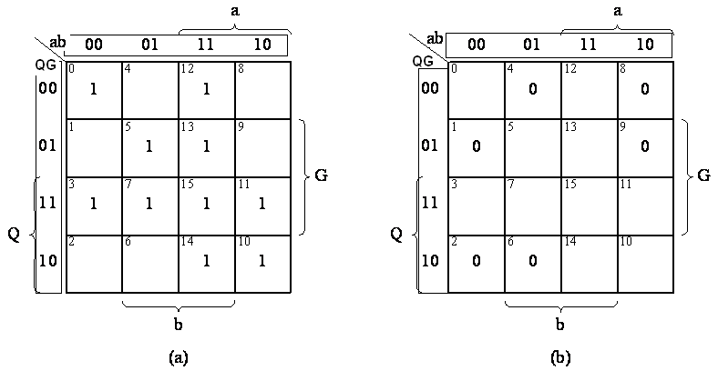
Four variable example
(a) Minterm form. (b) Maxterm form.
f(a,b,Q,G) = ∑m(0,3,5,7,10,11,12,13,14,15) = ∏M(1,2,4,6,8,9)

Slide 9
Simplification of Boolean Functions
Using K-maps
K-map cells that are physically adjacent are also logically adjacent. Also, cells on an edge of a K-map are logically adjacent to cells on the opposite edge of the map.
If two logically adjacent cells both contain logical 1s, the two cells can be combined to eliminate the variable that has value 1 in one cell’s label and value 0 in the other.

Slide 10
Simplification Guidelines for K-maps
Always combine as many cells in a group as possible. This will result in the fewest number of literals in the term that represents the group.
Make as few groupings as possible to cover all minterms. This will result in the fewest product terms.
Always begin with the largest group, which means if you can find eight members group is better than two four groups and one four group is better than pair of two-group.

Slide 11
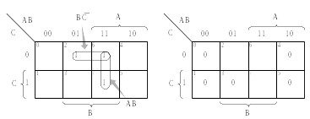
Example
Simplify f= A`BC`+ A B C`+ A B C using;
(a) Sum of minterms. (b) Maxterms.
Each cell of an n-variable K-map has n logically adjacent cells.
F`= B`+ A`C
F = B(A+C`)
a- f(A,B,C) = AB + BC′
b- f(A,B,C) = B(A + C′)

Slide 12
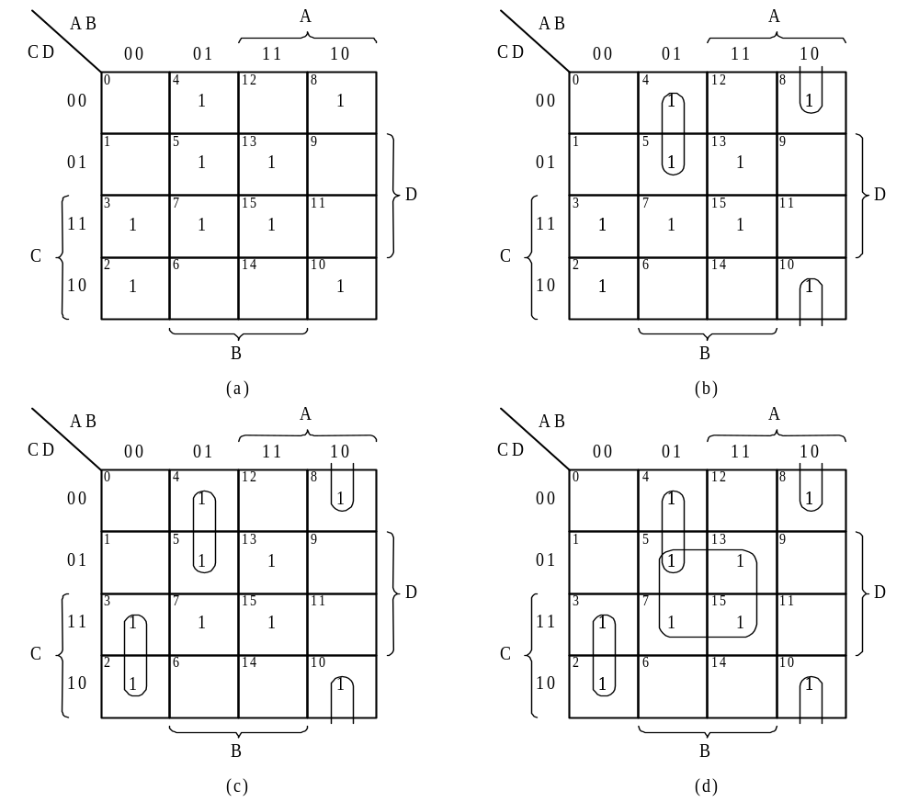
Example Simplify
f(A,B,C,D) = ∑m(2,3,4,5,7,8,10,13,15)

Slide 13
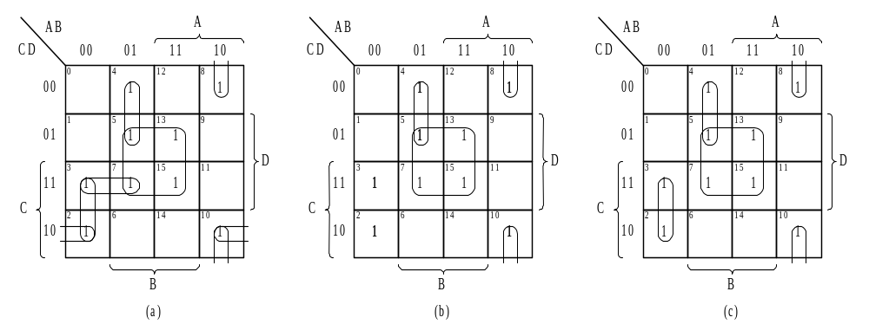
Example Multiple selections
f(A,B,C,D) = ∑m(2,3,4,5,7,8,10,13,15)
c produces less terms than a

Slide 14
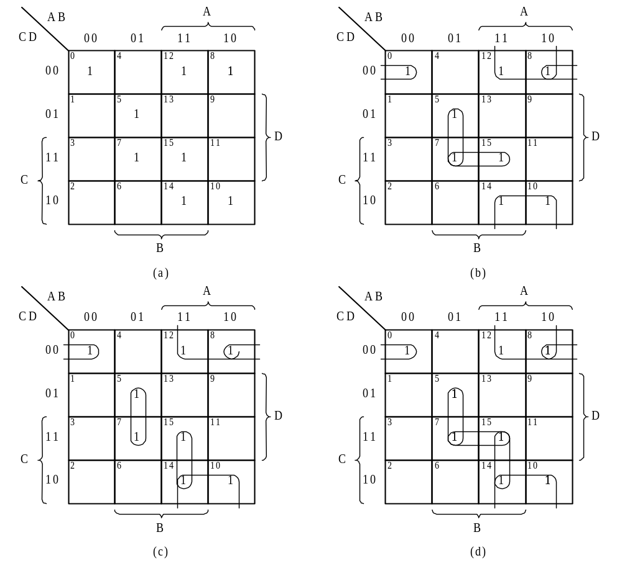
Example Redundant selections f(A,B,C,D) = ∑m(0,5,7,8,10,12,14,15)

Slide 15
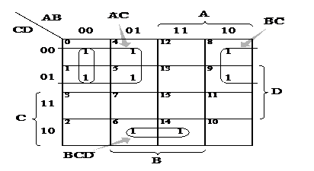
Example

Slide 16
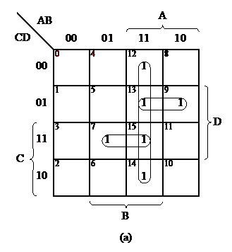
Example

Slide 17
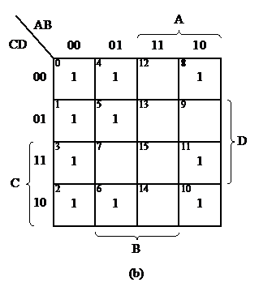
Example

Slide 18
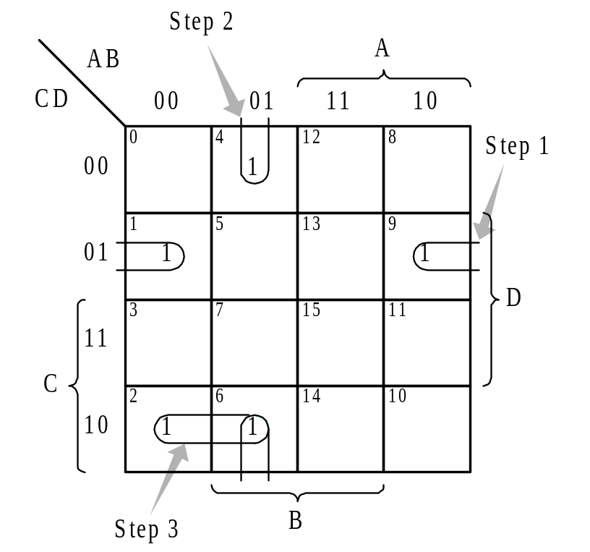
f(A,B,C,D) = ∑m(1,2,4,6,9)

Slide 19
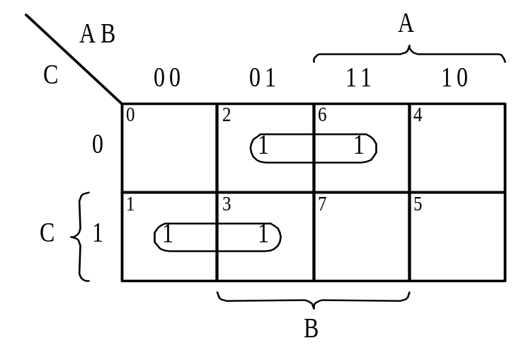
Different styles of drawing maps f(A,B,C) = ∑m(1,2,3,6) = A′C + BC′
BC
A
00
01
11
10
1
1
1
0
1
1
C
0
1
AB
 | 1
1 | 1
1
00
01
11
10

Slide 20
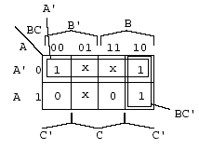
Don’t-care condition
Minterms that may produce either 0 or 1 for the function.
They are marked with an × in the K-map.
This happens, for example, when we don’t input certain minterms to the Boolean function.
These don’t-care conditions can be used to provide further simplification of the algebraic expression.
(Example) F = A`B`C`+A`BC` + ABC`
d=A`B`C +A`BC + AB`C
F = A` + BC`

Slide 21
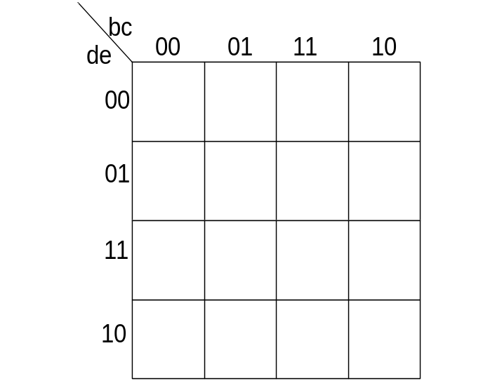
Five variable K-maps
Use Two Four-variable K-Maps
a` | f
0 | 1
1
2
3
4
5 | 1
6
7 | 1
8
9
10
11
12
13 | 1
14
15 | 1
a | f
16 | 1
17
18
19
20
21 | 1
22
23 | 1
24
25
26
27
28
29 | 1
30
31 | 1
f(a,b,c,d,e) = ∑m(0,5,7,13,15,16,21,23,29,31)
a`=0 map
a=1 map
1
1
1
1
1
1
1
1
1
1

Slide 22
F=(a+a`)ce + (a+a`)b`c`d`e`
=ce + b`c`d`e`
a`=0 map
a=1 map
1
1
1
1
1
1
1
1
1
1
F1=a`b`c`d`e` + a`ce, F2=ace + ab`c`d`e`
f(a,b,c,d,e) = f1+f2

